Slide 1





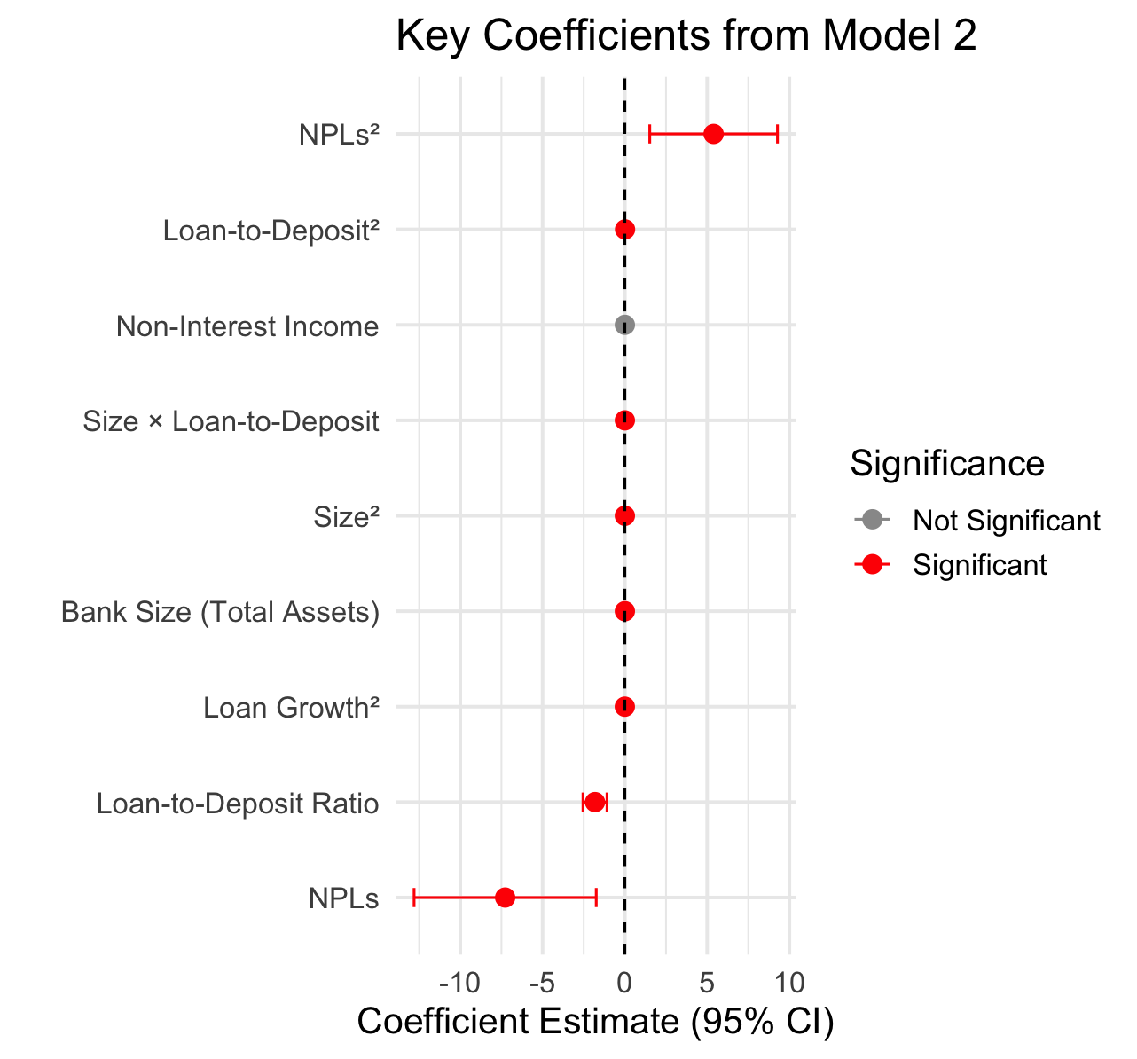

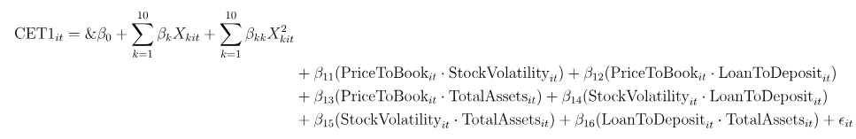
Why Do U.S. Banks Hold Excess Capital Beyond Regulatory Requirements
after the 2017 Basel III CET1 Requirements?
Suryansh Agrawal
Department of Data Analytics, Denison University
Department of Economics, Denison University
Motivation
Methodology
Results (Cont.)
Following the implementation of Basel III in 2017, U.S. banks have continued to hold equity capital well above regulatory minimums. This paper investigates the motivations behind this behavior, challenging the assumption that regulatory requirements alone drive capital levels. Drawing from Minsky’s Financial Instability Hypothesis and market discipline literature, the study explores whether excess capital reflects precautionary motives, profitability strategies, systemic risk perceptions.
To examine the determinants of excess bank capital, I estimate two fixed-effects panel regression models using annual data from 2016 to 2023. The models control for unobserved heterogeneity across banks and allow for robust inference through clustered standard errors.
Model 1: Assesses the relationship between profitability (ROA) and excess CET1 capital.
My regression analysis reveals a nonlinear and interactive structure underlying bank capital decisions. Key determinants such as asset quality, size, and lending behavior exhibit statistically significant effects on CET1 ratios, with both linear and quadratic terms shedding light on strategic capital management patterns.
Model 2: Includes additional controls: size, market risk, and loan growth, to test for robustness and broader firm-level drivers
Using the following null and alternative hypotheses:
H0​: μ1​=μ2
HA​: μ1​≠μ2​
I perform a two-sample t-test. The resulting p-value is approximately 0.0, allowing me to reject the null hypothesis at conventional significance levels. This indicates that the difference in means is statistically significant..
Theoretical Framework
Implications on Financial Stability and Policy
Minsky’s Financial Instability Hypothesis: Financial systems are inherently prone to instability. Excess capital may act as a cushion against boom-bust credit cycles.
Modigliani–Miller (1958): Theory vs. Practice: While capital structure is theoretically irrelevant under perfect markets, real-world frictions incentivize conservative capital behavior.
Market Discipline & Expectations: Investors reward prudence: banks may hold excess CET1 to signal strength and avoid market penalties.
Both models aim to isolate economic and risk-based incentives behind capital buffer decisions
Why Do These Results Matter? This study finds that banks with stronger profitability hold more capital above regulatory minimums, suggesting excess CET1 capital serves not only as regulatory compliance—but also as a strategic choice enhancing resilience
Resilience and Systemic Stability
Profitable banks tend to self-insure by building buffers—supporting a Minskyan “hedge finance” regime.
Well-capitalized banks sustain credit during downturns, especially to SMEs.
Aligning incentives with capital regulation enhances systemic stability.
Behavioral Constraints on Buffer Usability
Despite policy intent, banks avoid using buffers due to fear of market penalties.
This limits countercyclical effectiveness of capital buffers.
Policy Recommendation: Improve regulatory communication, allow temporary dividend flexibility, and refine Stress Capital Buffer (SCB) frameworks.
Rethinking the Capital–Lending Tradeoff
Evidence contradicts the view that capital reduces lending.
Better-capitalized banks lend more downturns, enabling growth, pro-stability regulation.
Results
Variable | Coefficient | Standard Error | p-value | Significance
ROA | 0.45 | 0.10 | 0.000 | ***
Bank Size (log assets) | -0.12 | 0.05 | 0.015 | **
NPL Ratio | -0.20 | 0.09 | 0.030 | *
Leverage | -0.30 | 0.11 | 0.006 | **
Constant | 7.50 | 0.80 | 0.000 | ***
R-squared | 0.62
Data
Data Source:
Bloomberg Terminal (February 2025)
BASEL III (January 2017)
Sample: 10 U.S. publicly traded banks (2016–2023)
Key Independent Variables:
Return on Assets (ROA)
Non-Performing Loan Growth (%)
Bank Size (log total assets)
Market Beta (volatility proxy)
Non-performing loans (NPLs) and their squared term are both statistically significant, indicating a strong nonlinear relationship: higher NPL levels are associated with lower CET1 ratios, but the marginal effect decreases at extreme values.
Loan-to-deposit ratio and bank size (total assets) negatively impact CET1, suggesting banks with more aggressive lending and larger balance sheets tend to hold lower excess capital.
The quadratic terms for loan-to-deposit ratio and bank size are positive and significant, reinforcing the idea of a U-shaped relationship: capital holdings decline initially but increase at high levels of leverage or size.
A significant interaction between size and loan-to-deposit ratio shows that larger banks with high loan intensity face a compounded capital effect.
Acknowledgements
Prof. Alexandre Scarcioffolo, Department of Data Analytics , Denison University.
Prof. Fadhel Kaboub, Department of Economics, Denison University.
Prof. Hyun Woong Park, Department of Economics, Denison University.

